Slide 1
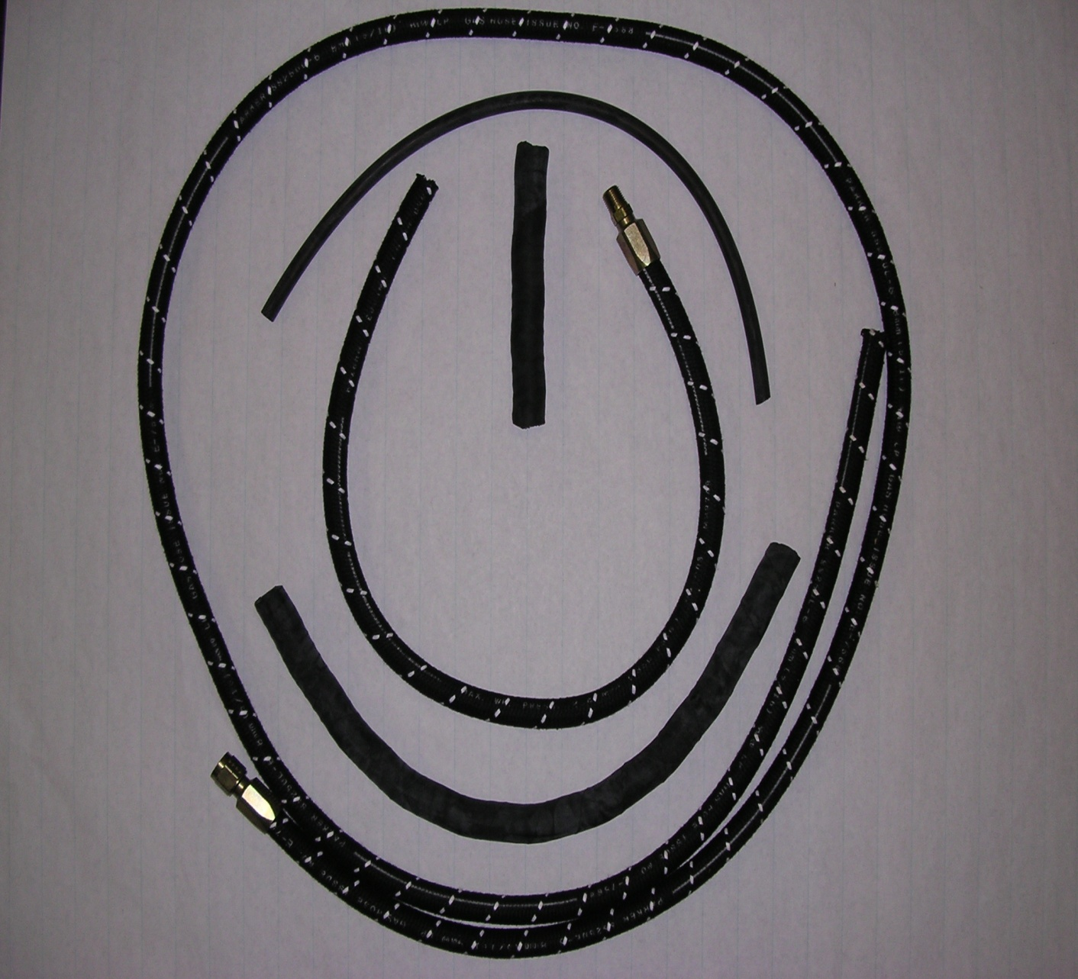
3333792 Kit/Fld–LP Hose Replacement (Ford 1.3L LPG)
3333797
3333799
Ftg-LPG ¼” MPT
Hose-Vacuum ¼” x 20”
3333793
Hose-Vapor/Water 6”
3333795
Hose-LPG 31”
3333794
Hose-Vapor/Water 19”
3333796 Hose-LPG 93”
3333798 Ftg-LPG 3/8” Female Flare

Slide 2
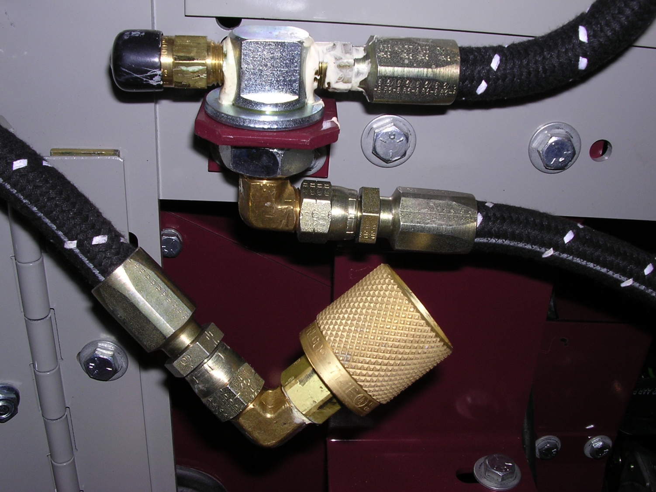
3333792 Kit/Fld–LP Hose Replacement (Ford 1.3L LPG)
3333776 Relief Valve LPG
3333777 Ftg-LPG Tee Bulkhead
3333798 Ftg-LPG 3/8” Female Flare
3333774 Ftg-3/8” Flare x ¼” MPT 90Deg
3333796 Hose-LPG 93”
Note:
3333797 Ftg-LPG
¼” MPT (no shown,
goes to LPG assembly
at engine end
of 3333796 Hose)
3333775 Ftg-LPG Fuel Line 3/8” Female Flare
3333773 Coupler-LPG Tank
3333795 Hose-LPG 31” (Relief Valve to Tank Coupler)
3333774 Ftg-3/8” Flare x ¼” MPT 90Deg

