Slide 1
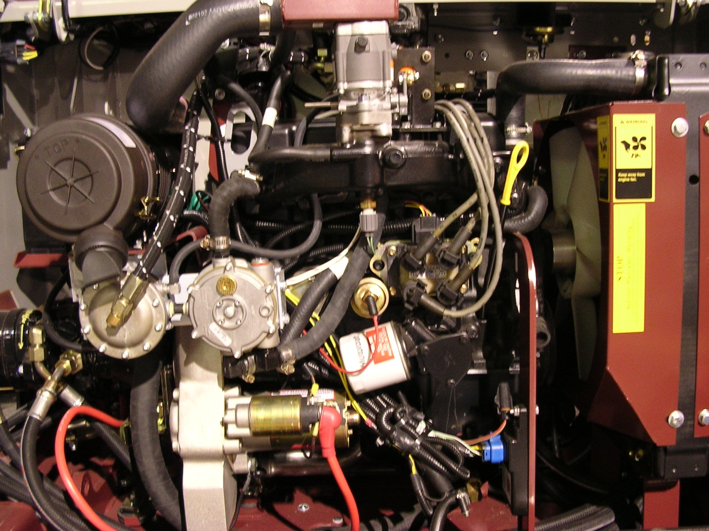
3333799 Hose-Vacuum 1 / 4” x 20”
3333793
Hose-Vapor/
Water 6”
3340171 Hose
By-Pass
3333796
Hose-LPG 93”
3334516 Ftg-
Water 5/8” Str
3334517 Ftg-
Vacuum 1 / 4” Str
3333798
Ftg-LPG 3/8”
Female Flare
3333794
Hose-Vapor/
Water 19”
3334514 Ftg-
Vapor 5/8” 90
3334515 Ftg- Water 5/8” 90
3316361 Shutoff-LPG
3324198 Regulator-LPG
3332746
Ignition Control
Module
3333795 Hose-LPG 31” (goes to LPG tank, not shown)
3333797 Ftg-LPG ¼” MPT (goes to 3333795 hose, not shown)

